Slide 1

RETAIL ANALYSIS
Guided by :
Dr. Mahshid Fardadi
Allen Bolourchi, Ph.D., MBA
Rahul Viswakarma
Teammates :
Arpitha Hiresadrahalli Dayananda
Keval Dharmendra Joshi
Soujanya Mulakalapally
Varshini Nathala Kaushal Brahmbhatt

Slide 2
Agenda
Understanding dataset
Data Visualization and analysis
Machine Learning model building
Model deployment and business recommendation

Slide 3
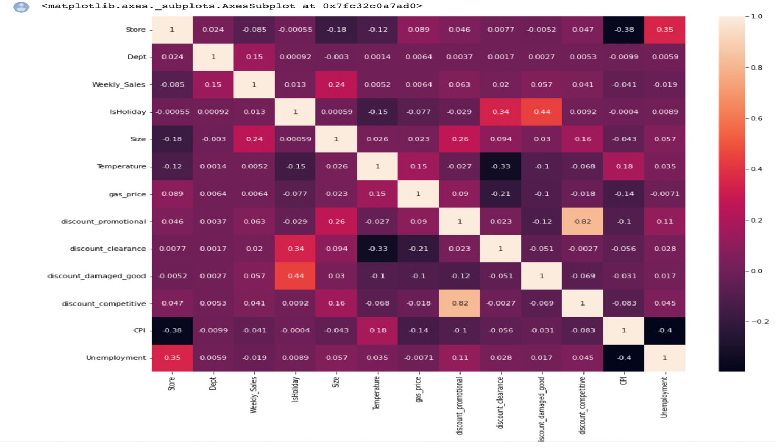
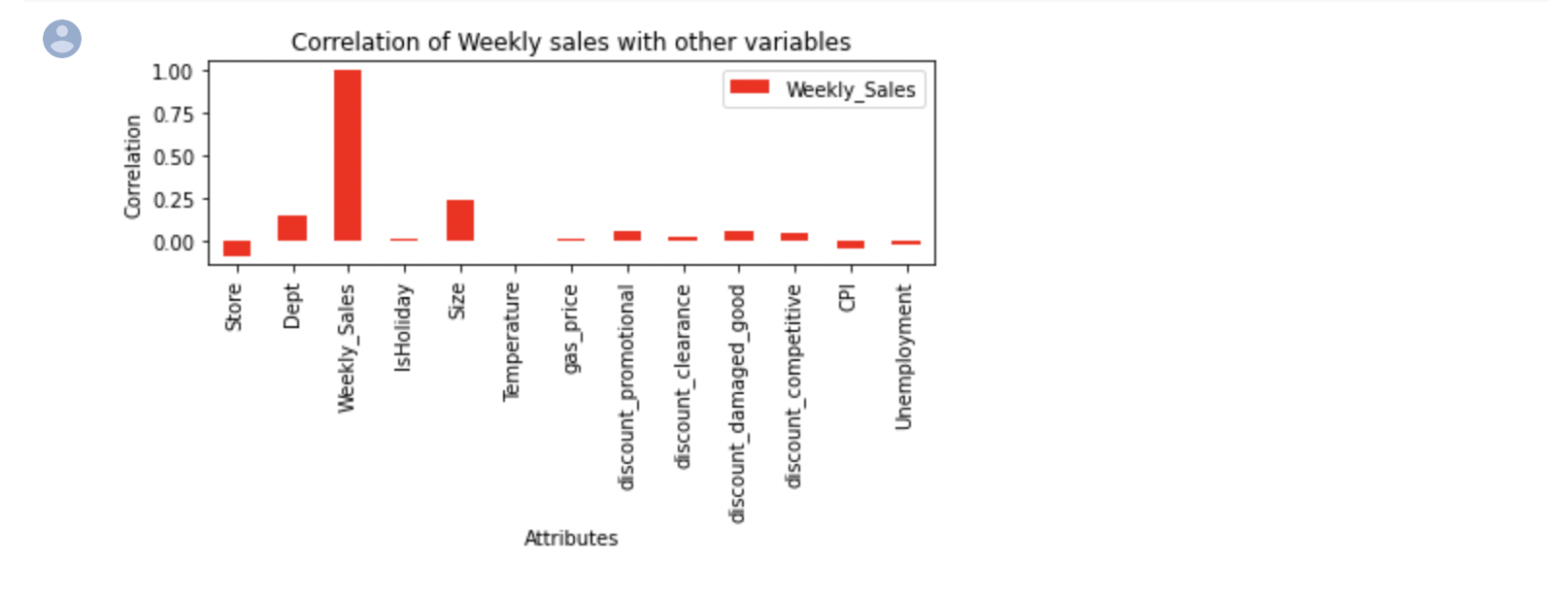
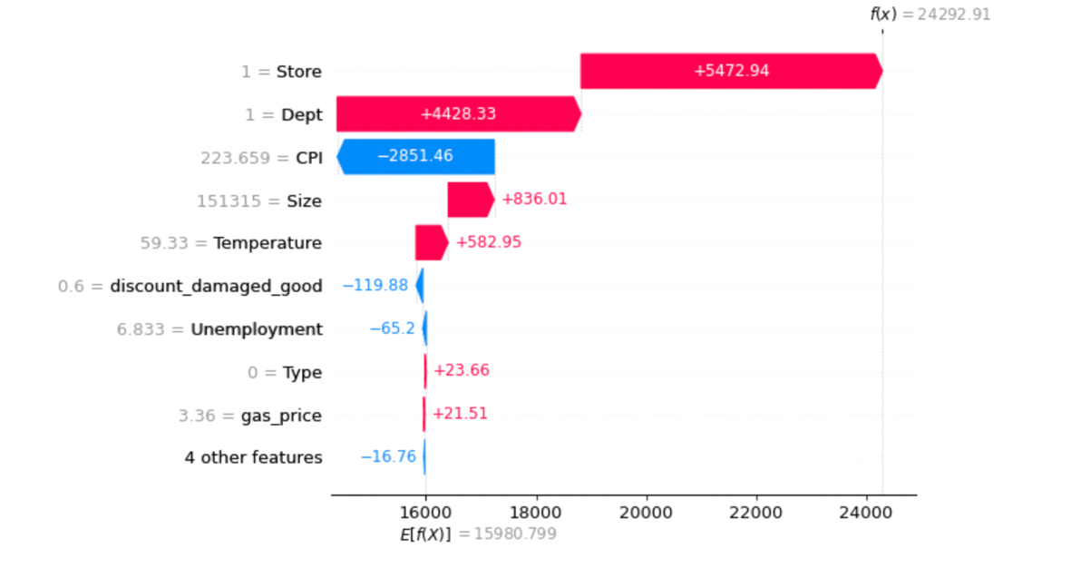
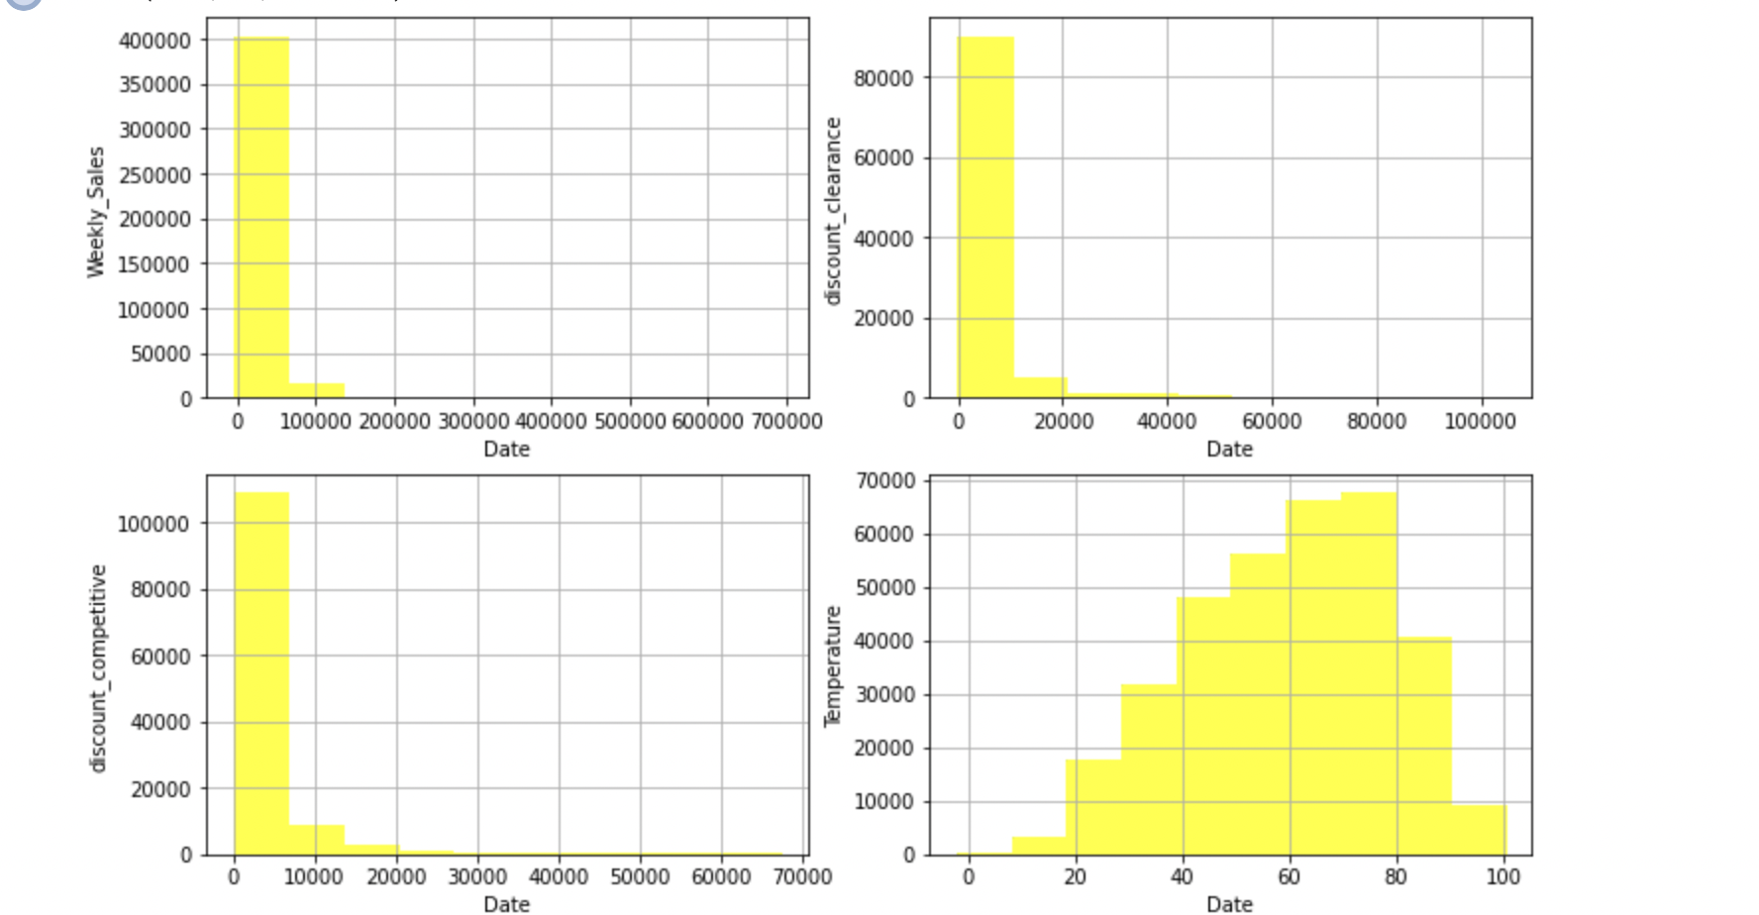
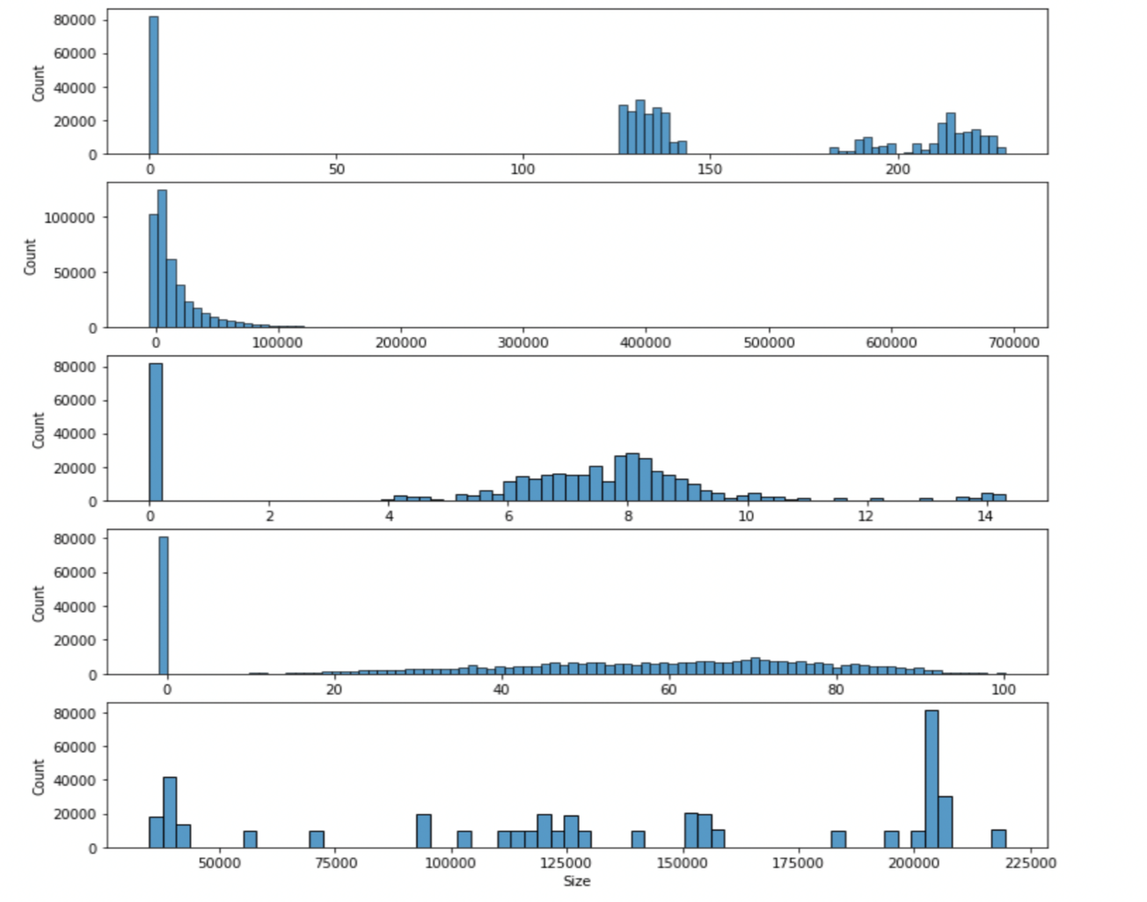
Data Visualization and analysis
Heat Map
Correlation bar graph
Shap plot
Histogram Analysis

Slide 4
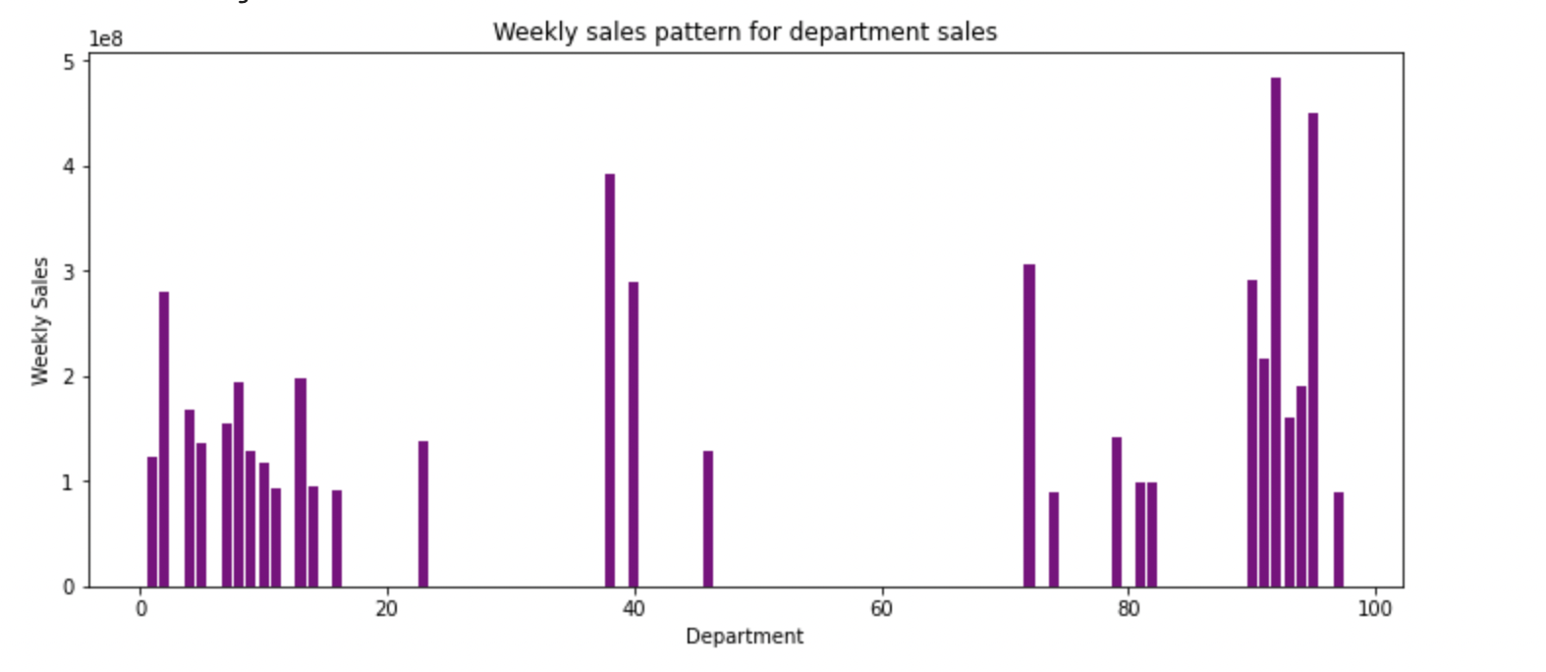
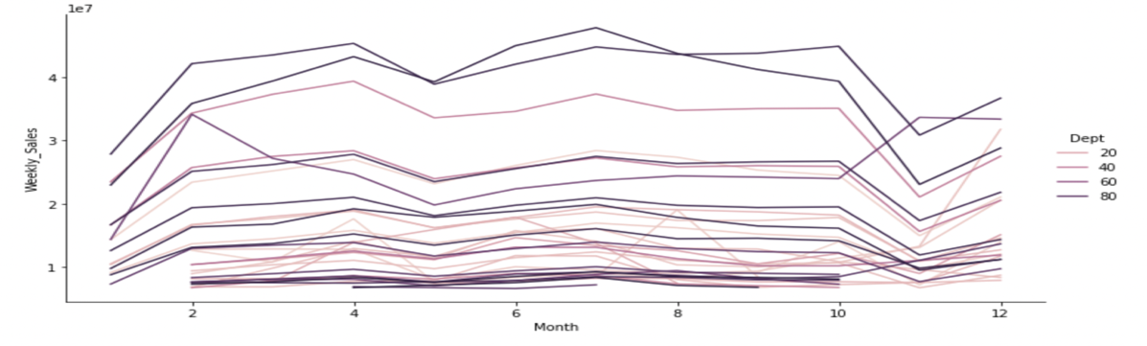
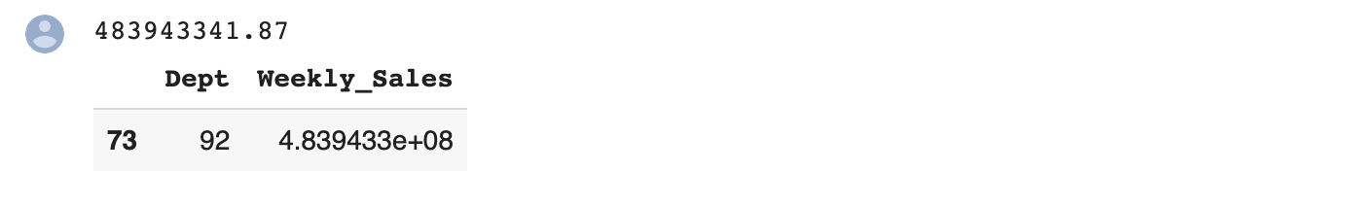
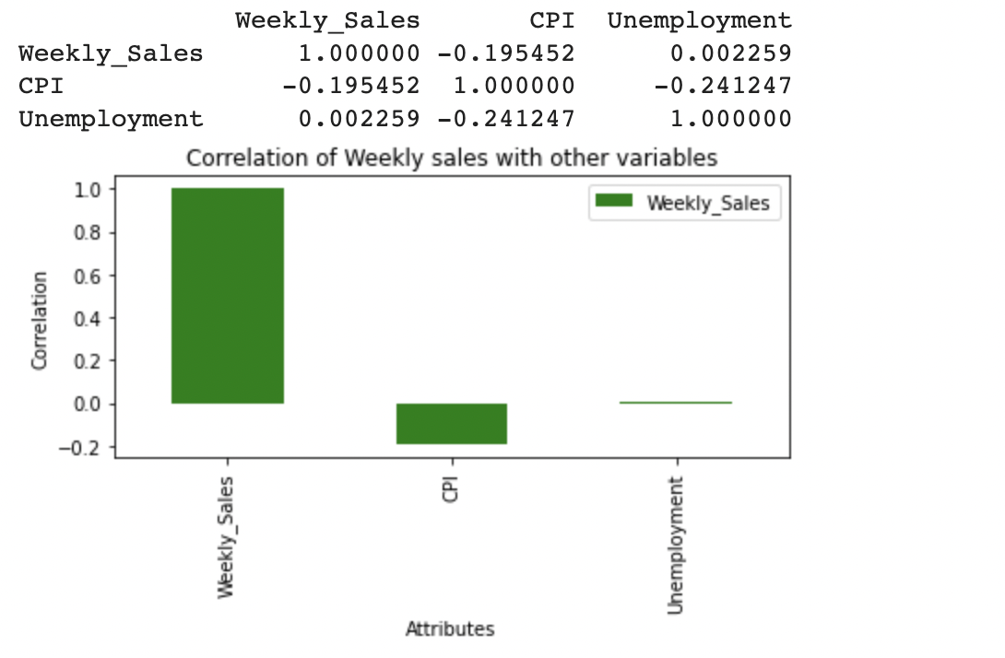
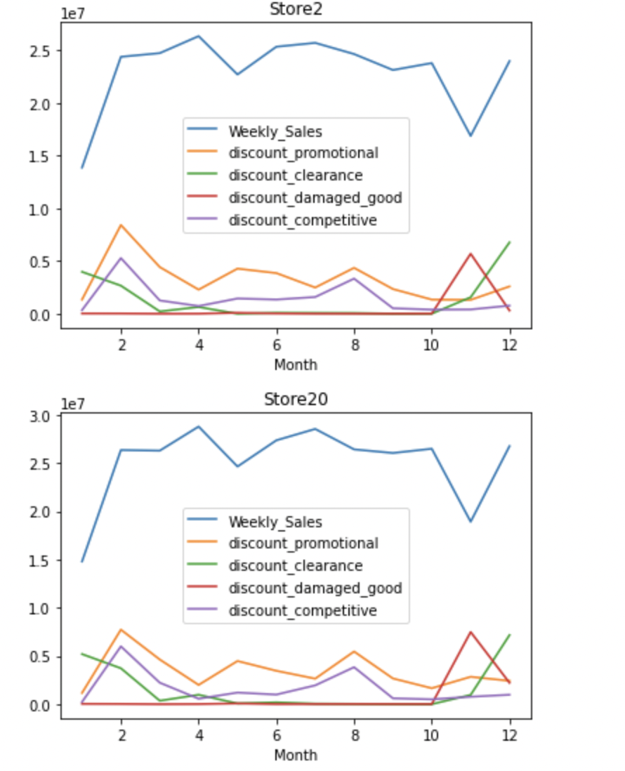
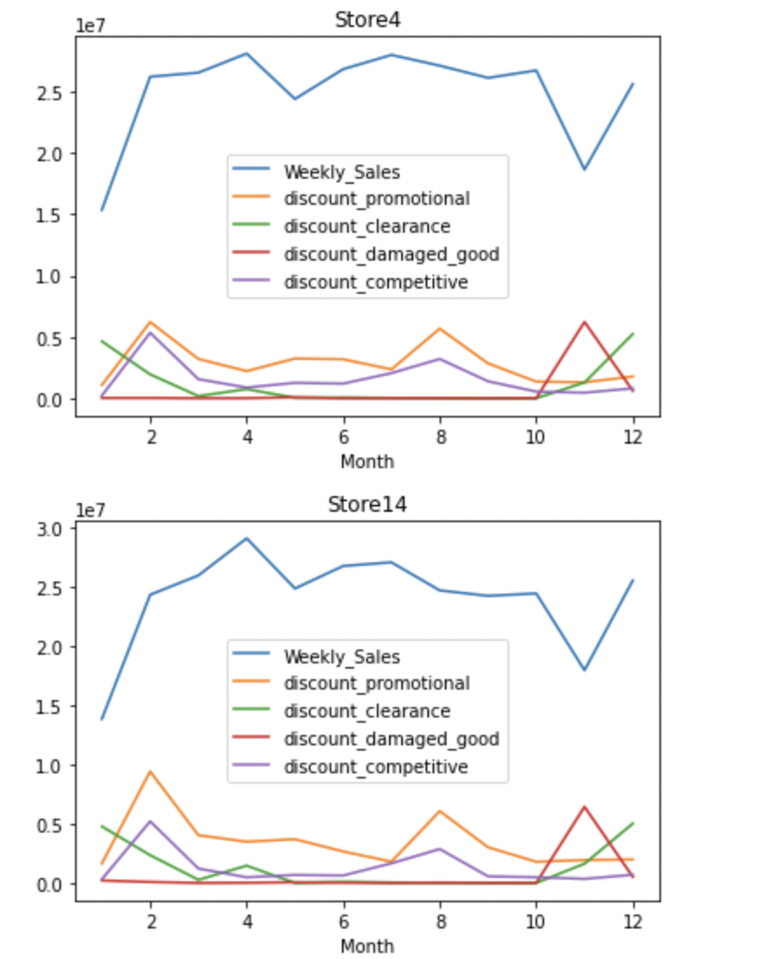
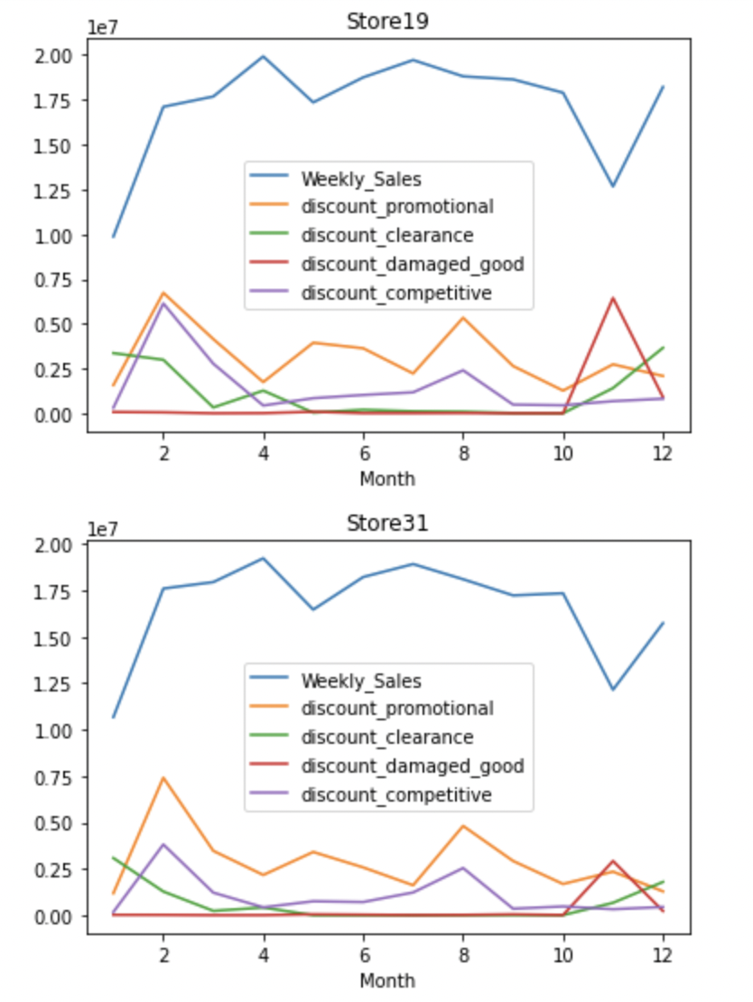
Data Visualization and analysis
Sales patterns for top 35% of the department sales?
Weekly sales pattern
Monthly Sales Pattern
Best Department
Relationship between weekly sales over CPI and unemployment ?
Discount is helpful in increasing sales?
The stores obtained are: 20, 4, 14, 13, 2, 10, 27, 6, 1, 39, 19, 31, 23.

Slide 5
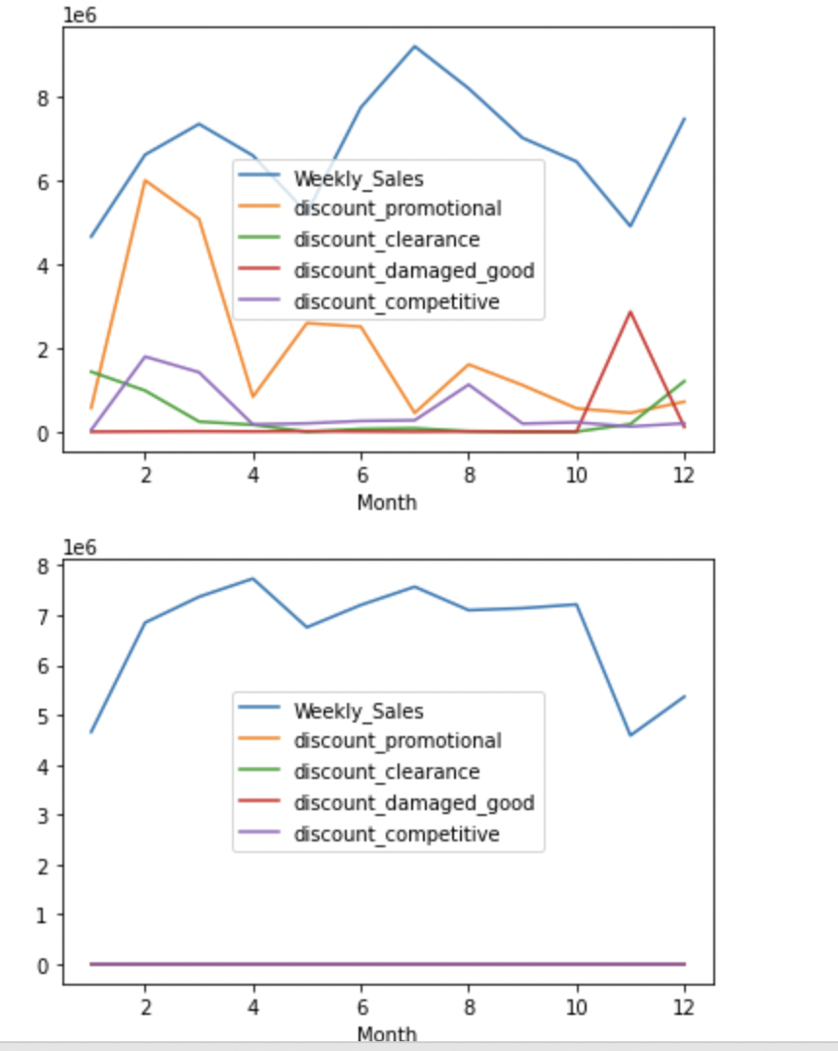
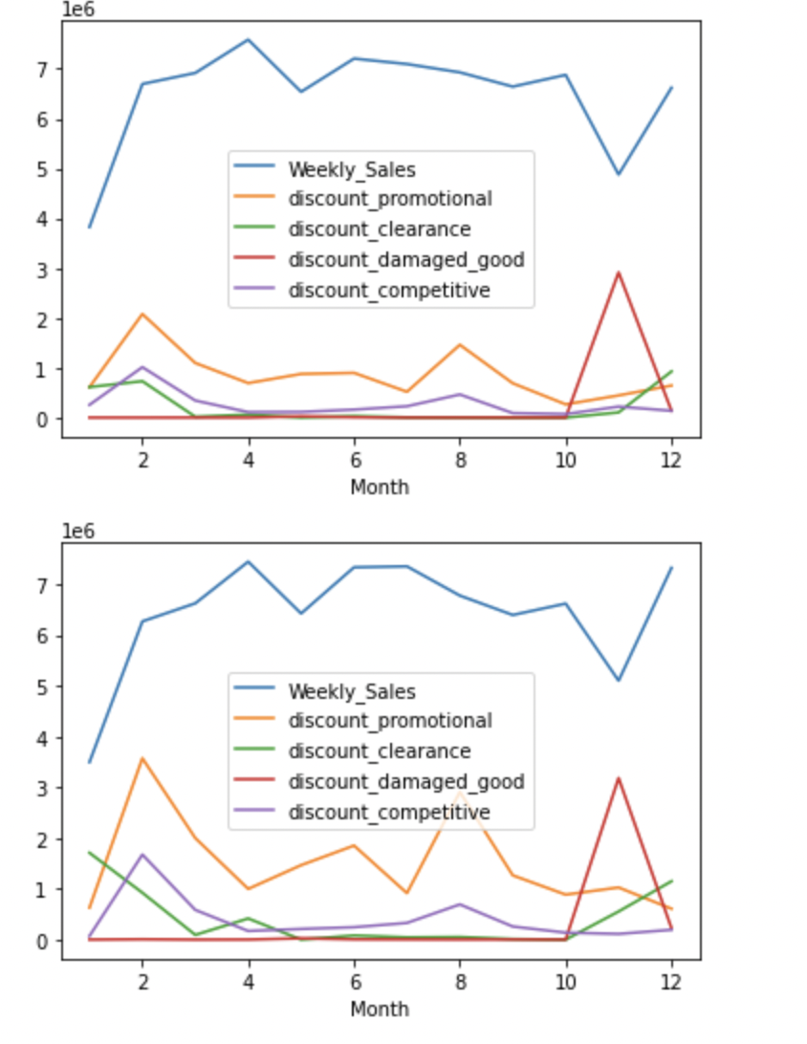
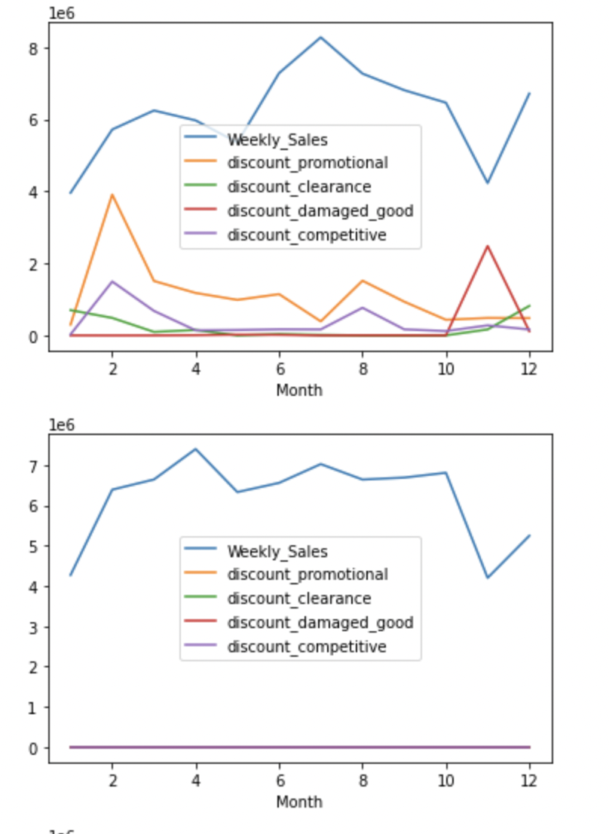
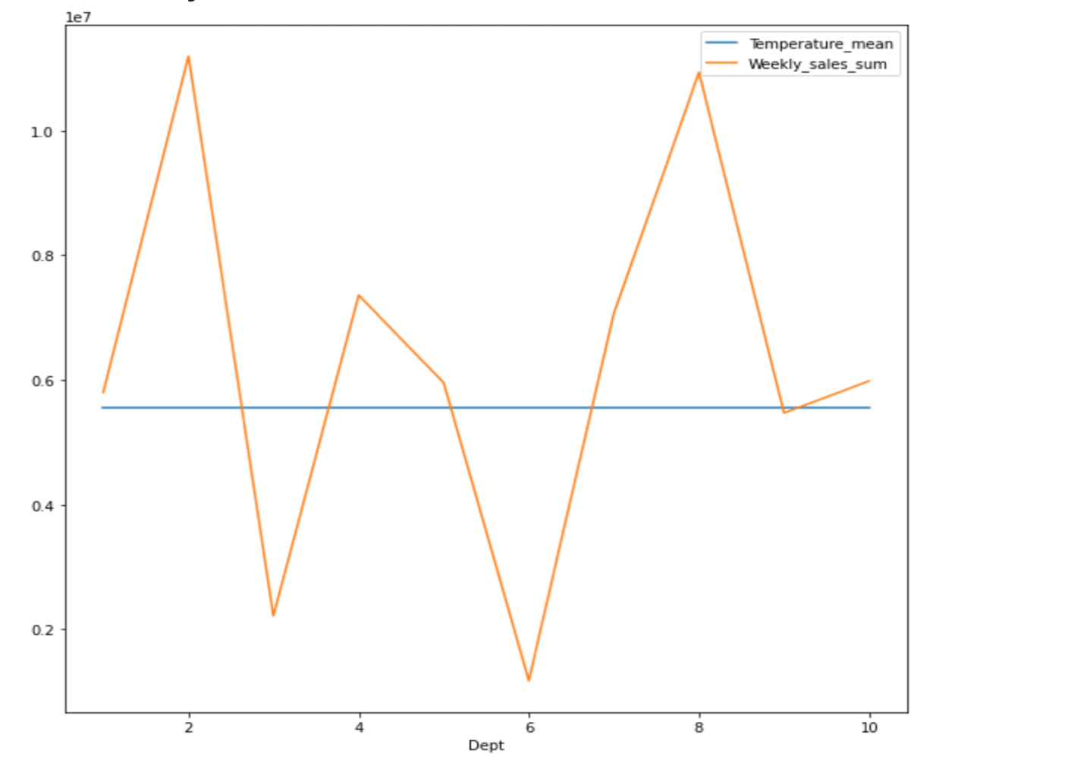
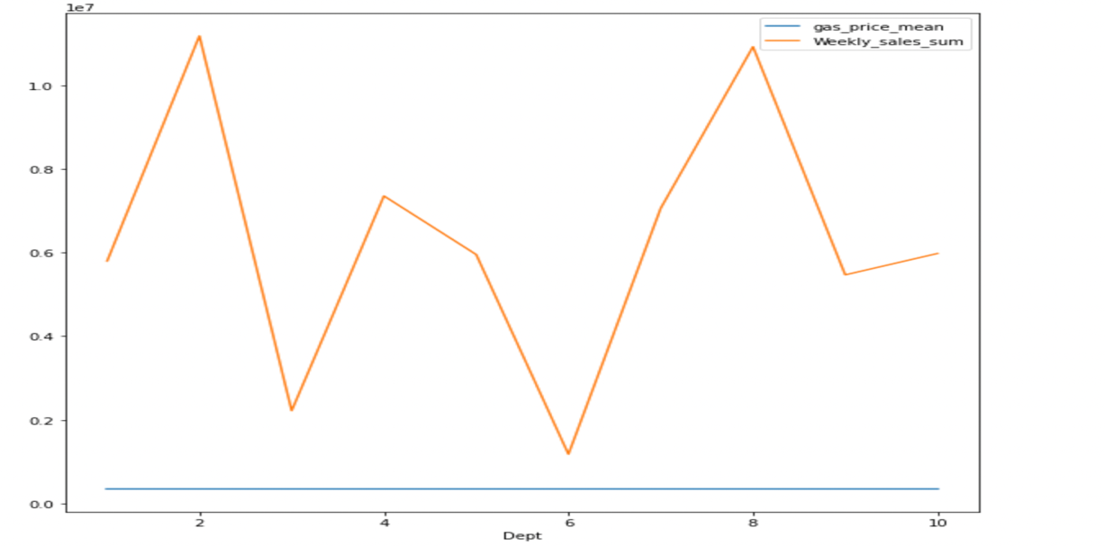
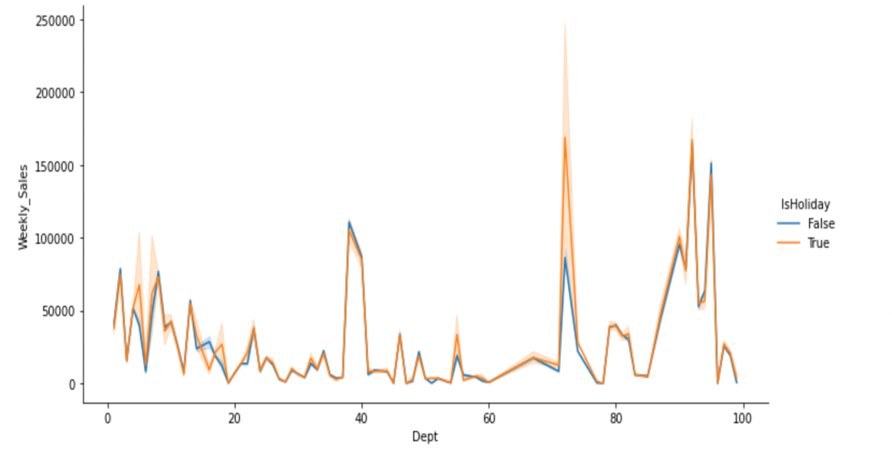
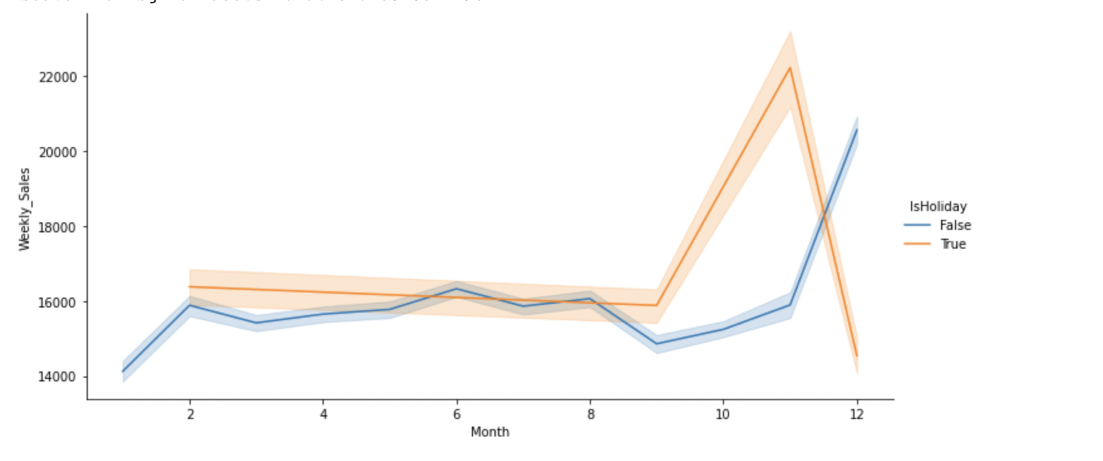
Data Visualization and analysis
Bottom 30% of least performing stores?
[7, 42, 9, 29, 16, 37, 30, 3, 38, 36, 5, 44, 33]
Products which are highly impacted by external factors
Temperature
Gasprice
Holiday
Correlation between overall sales and holiday

Slide 6
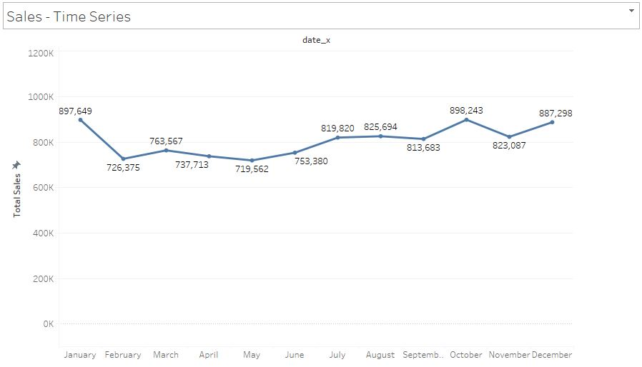
Data Visualization and analysis
The dataset shows the unit sales (in terms of quantity and number) of different goods sold in the USA, arranged as grouped time series.
More specifically, the dataset includes the unit sales of about 3000 products that are divided into 7 product departments that are subdivided into the three aforementioned categories (Hobbies, Foods, and Household) and three more product categories.
Ten locations, spread over three states, sell the products (CA, TX, and WI). This data can be grouped based on geography (store and state) or product-related information.
The most disaggregated data in this regard is product-store unit sales (department and category).

Slide 7
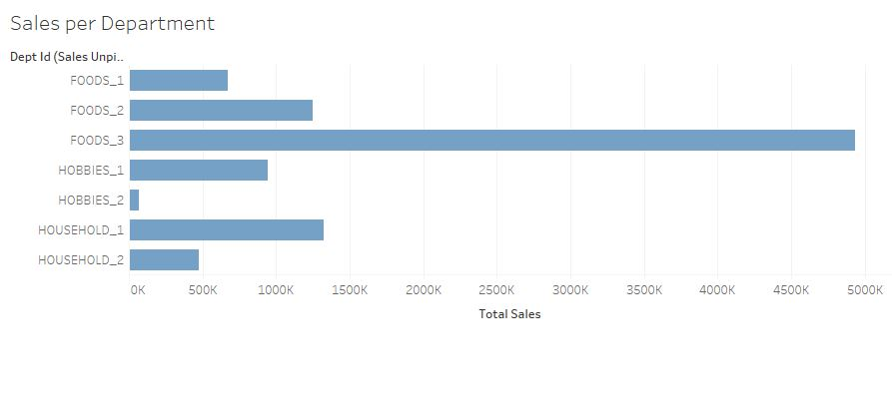
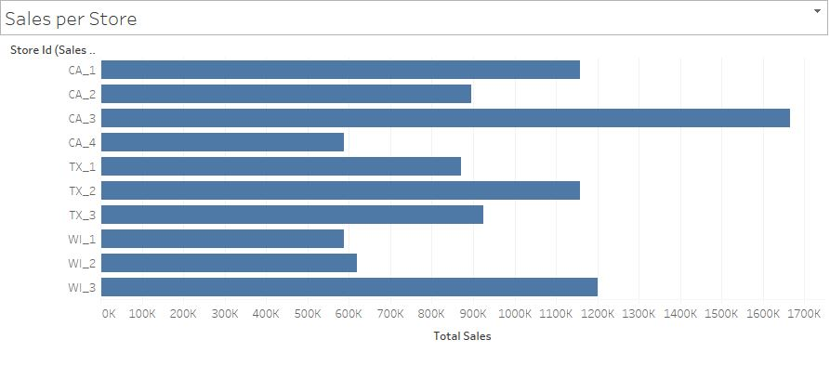
Data Visualization and analysis
We have plotted many such graphs via data visualization where each graph represents the sales that occurred in different categories.
The first graphs represents the number sales occurred in different categories. It is plotted based on categories versus its total sales.
The second graph represents the sales over different stores in three different states. Here, the bars represents the sales in all the categories like foods, households and hobbies.

Slide 8
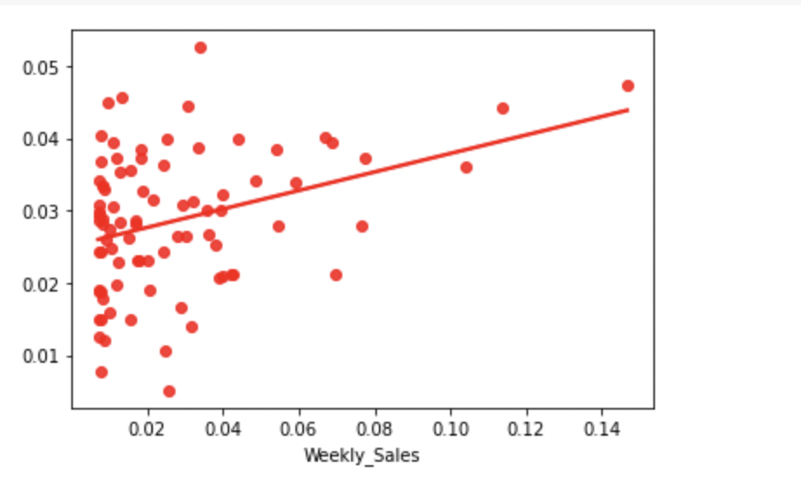
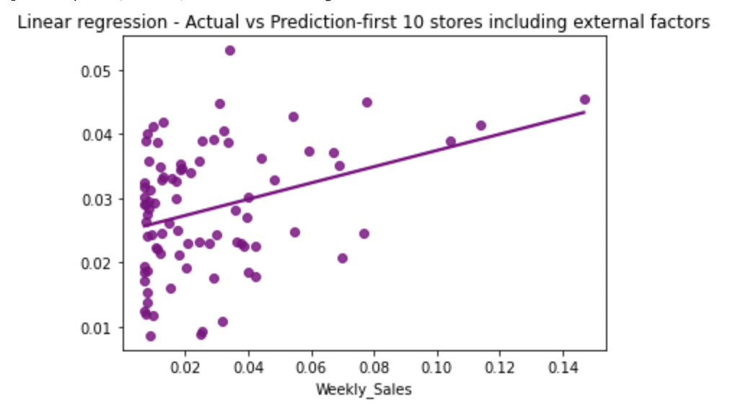
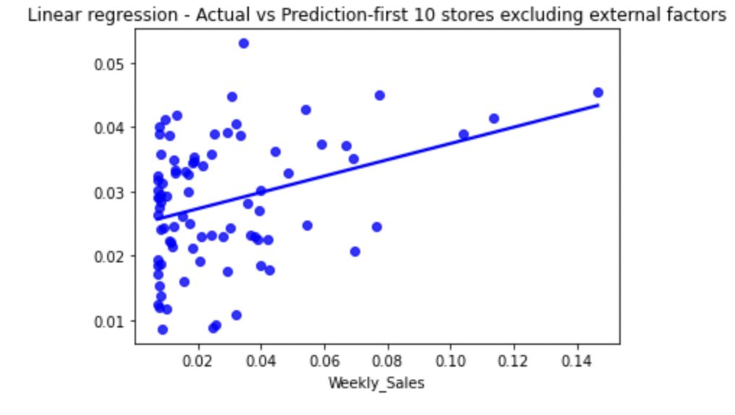
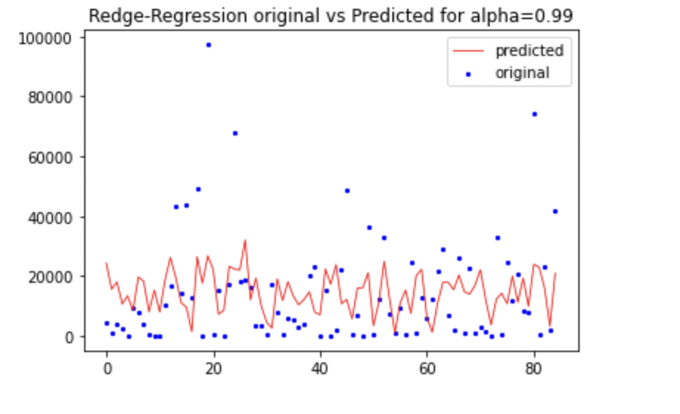
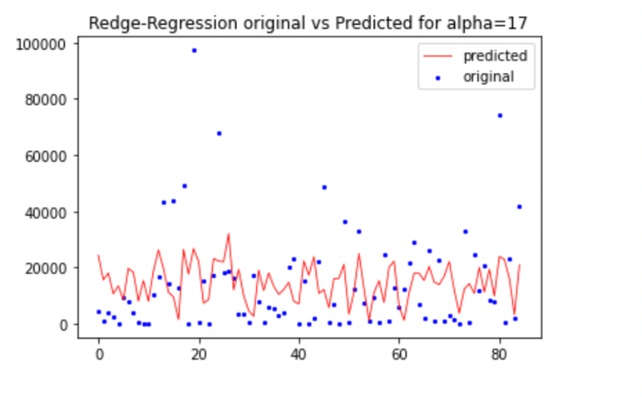
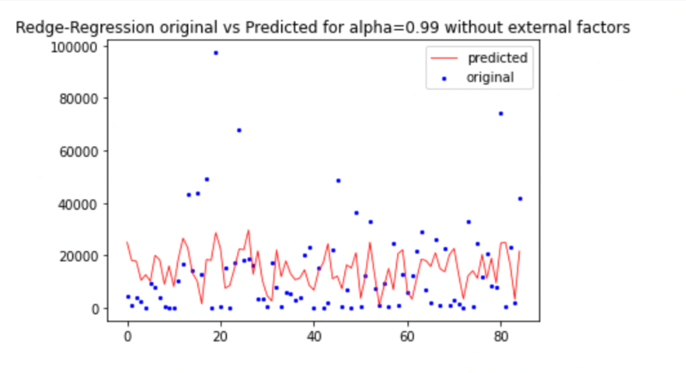
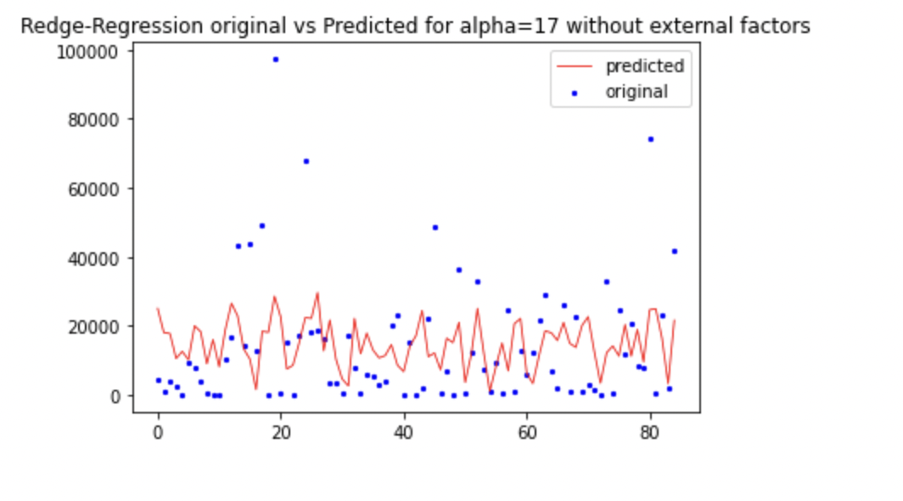
Machine Learning Model Building
Linear regression
Entire dataset
With External Factors-Store 11-35
The Mean Absolute Error of the model:12947.484232170704 The Mean Squared Error of model: 287677820.7140935
The score of the model: 9.970060703050343
Without External Factors- Store 11-35
The Mean Absolute Error of model: 750952802.3878015
The Mean Squared Error of model: 6.664603315736966e+17
The Mean Absolute Error of the model: 0.01831734909788
The Mean Squared Error of the model: 0.000581387477500
Score of the model:11.3319
Ridge Regression
With external factors(stores 1-10)
Without external Factors(stores 1-10)
Store 11-35 with external factors
Store 11-35 Without external Factors
Alpha = 0.99
Alpha =17
Alpha = 0.99
Alpha =17
Alpha=0.99
Alpha =0.99
The Mean Absolute Error of model: 749554282.2603292
The Mean Squared Error of the model: 6.639773187940716e+17
The Mean Absolute Error of model: 538816648.6142223
The Mean Squared Error of model: 3.46853855204516e+17
Alpha =17
The Mean Absolute Error of model: 531161862.4061004
The Mean Squared Error of model: 3.363647237238198e+17
Alpha =17
The Mean Absolute Error of model: 726101146.5481724
The Mean Squared Error of model: 6.22996448984605e+17

Slide 9
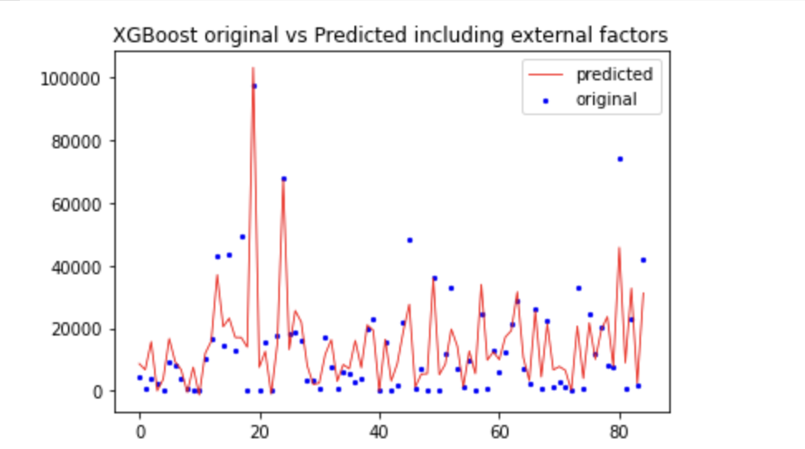
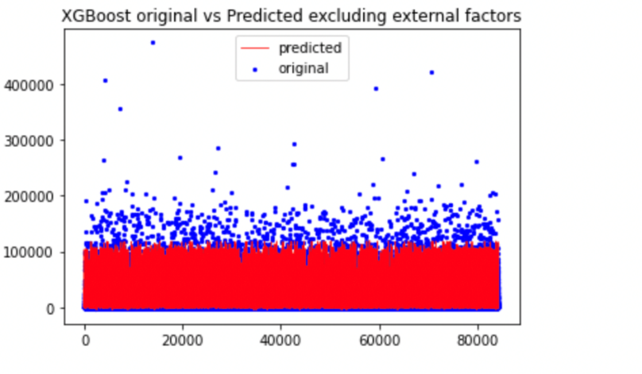
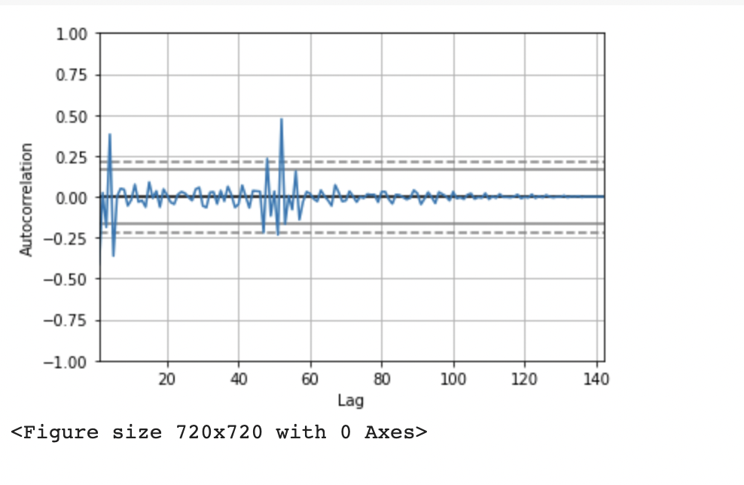
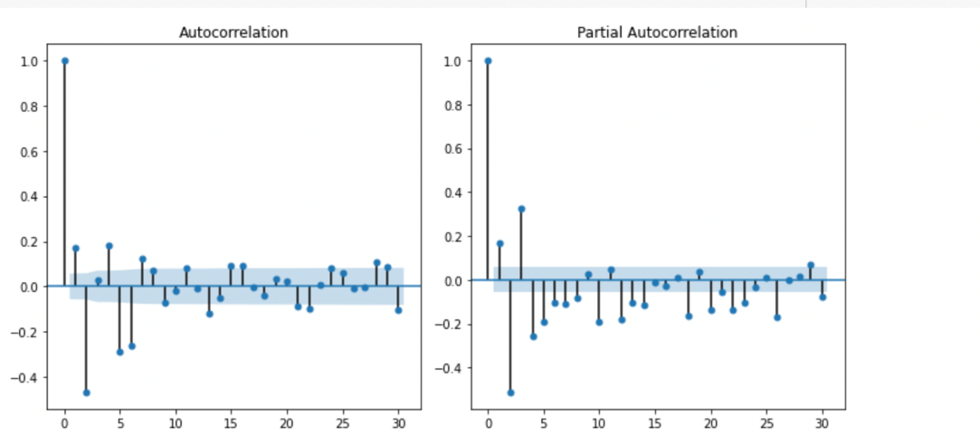
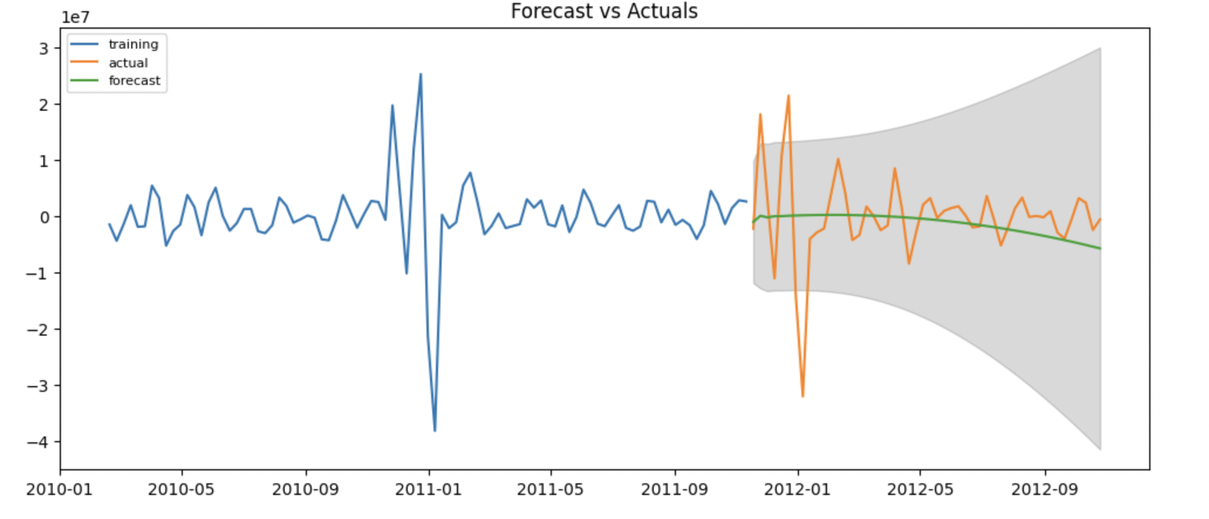
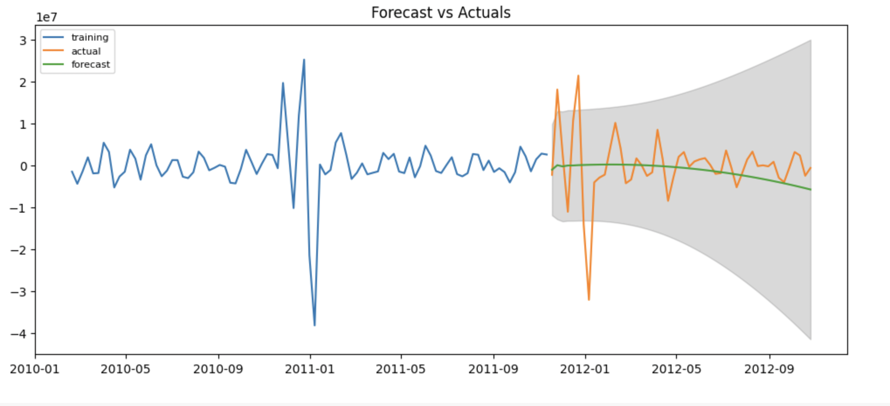
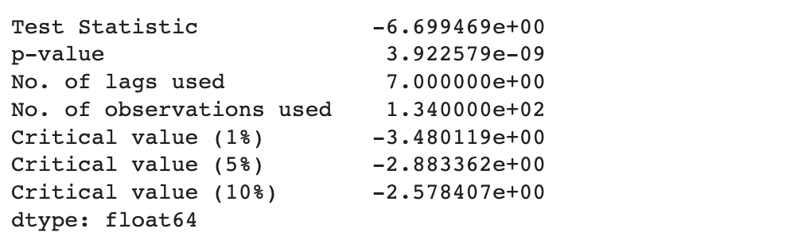
Machine Learning Model Building
XGBOOST
With external Factors store 1-10
Without External Factors Store 1-10
With external Factors Store 11-35
The Mean Absolute Error of the model: 14637.136522168374
The Mean Squared Error of model: 713584790.303554
Without External Factors Store 11-35
The Mean Absolute Error of model: 7907.349560543148
The Mean Squared Error of model: 176413525.03579786
The score of the model: 70.33766996430388
Arima
Stores 1-10
p,q values using ACF and PACF
Forecat vs Actual
Stores1-10
Store 11-35
Values of p =1 , q= 2, d = 2

Slide 10
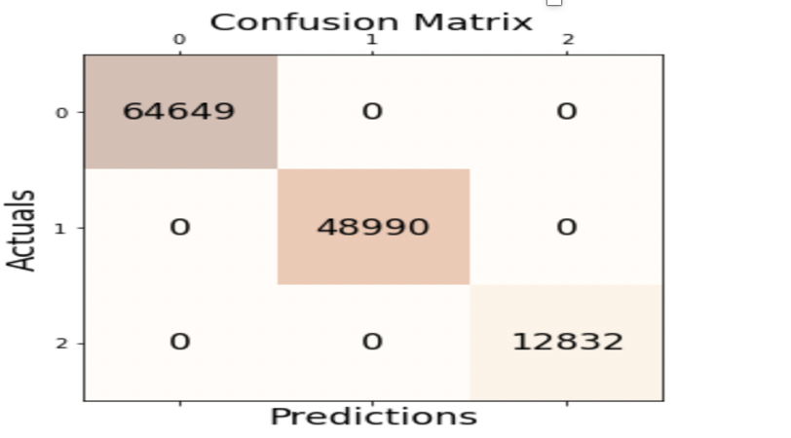
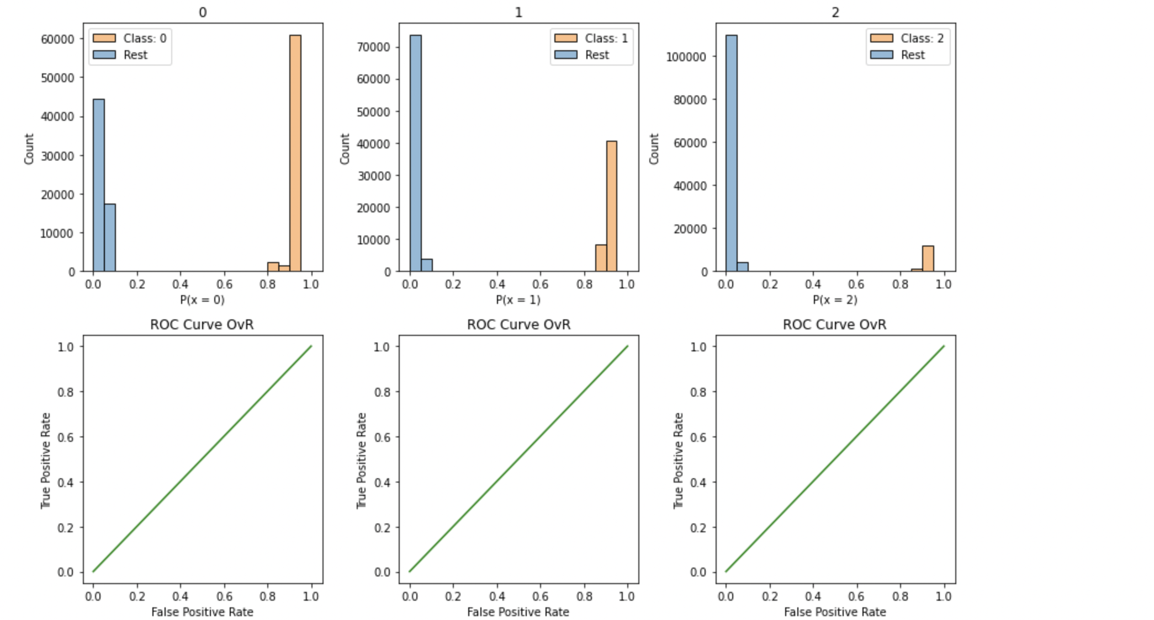
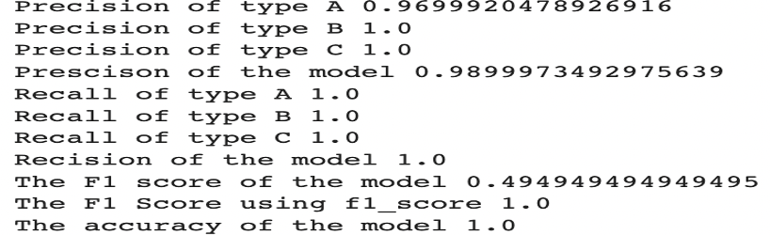
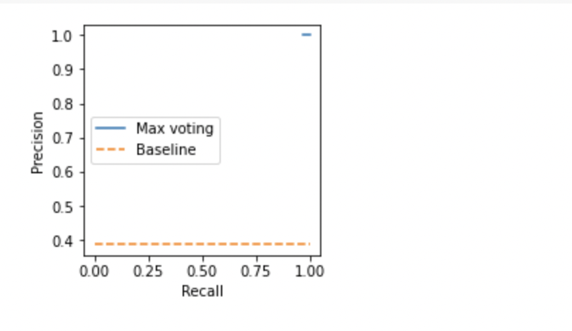
Machine Learning Model Building
Tabulation of performance metrics comparison
With External Factors
Without External Factors
 | First 10 stores (combined data) | store_11_35
Ridge Regression alpha = 0.9 | Mean Absolute Error: 12950.681646965293 Mean Squared Error: 285034767.05530965 Score of the model: 10.797215051857023 | Mean Absolute Error : 538816648.6142223 Mean Squared Error: 3.46853855204516e+17
Ridge Regression alpha = 17 | Mean Absolute Error: 12948.260201271554 Mean Squared Error: 285033850.9289698 Score of the model: 10.79750175730606 | Mean Absolute Error: 531161862.4061004 Mean Squared Error: 3.363647237238198e+17
XGBOOST | The Mean Absolute Error of model: 5366.568656285903 The Mean Squared Error of model: 62624069.31912708 The Score of the model: 80.40154383353625 | Mean Absolute Error: 14637.136522168374 Mean Squared Error: 713584790.303554
Linear Regression | The Mean Absolute Error of model: 0.01855187754044593 The Mean Squared Error of model:0.0005848934202279076 Score of the model: 10.797293492534887 | The Mean Absolute Error of model: 16806.548378199703 The Mean Squared Error of model: 870403893.024495
 | First 10 stores (combined data) | store_11_35
Ridge Regression alpha = 0.9 | Mean Absolute Error: 12947.425132618266 Mean Squared Error: 287677944.4260363 Score of the model: 9.970021986896727 | Mean Absolute Error: 749554282.2603292 Mean Squared Error: 6.639773187940716e+17
Ridge Regression alpha = 17 | Mean Absolute Error: 12946.41725218746 Mean Squared Error: 287674303.74608207 Score of the model: 9.971161352435798 | Mean Absolute Error : 726101146.5481724 Mean Squared Error of: 6.22996448984605e+17
XGBOOST | The Mean Absolute Error: 6968.396529056831 The Mean Squared Error of model: 133086926.60173918 Score of the model: 73.90463013091836 | Mean Absolute Error: 7907.349560543148 Mean Squared Error: 176413525.03579786 Score of the model: 70.33766996430388
Linear Regression | The Mean Absolute Error of the model:12947.484232170704 The Mean Squared Error of model: 287677820.7140935 Score of the model: 9.970060703050343 | The Mean Absolute Error of model: 750952802.3878015 The Mean Squared Error of model: 6.664603315736966e+17
Arima | First 10 stores (combined data) | store_11_35
Arima | The mean absolute error: 5057731.956916306 The mean squared error: 59566858694429.85 The mean absolute percentage error: 3.9233489986639842 The score : 92.32999999999998 | The mean absolute error: 5057731.956916306 The mean 59566858694429.85 The mean absolute percentage error: 3.9233489986639842 The score : 92.32999999999998
Ensemble Model
Precision , Recall, F1, the Accuracy score
Precision-Recall
ROC curve

Slide 11
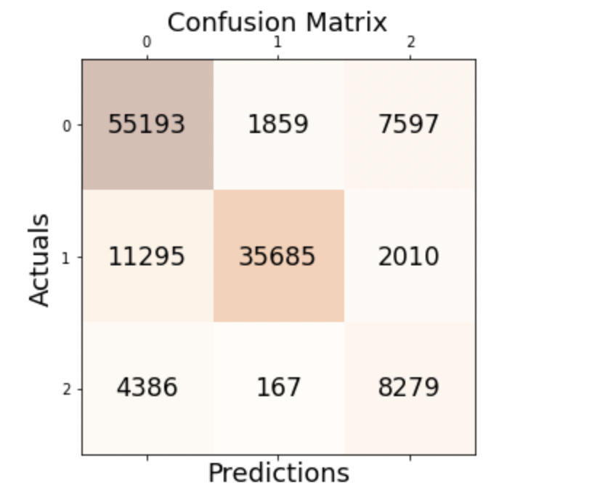
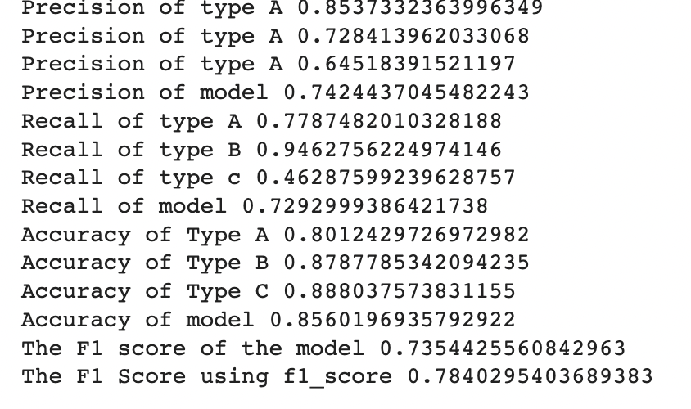
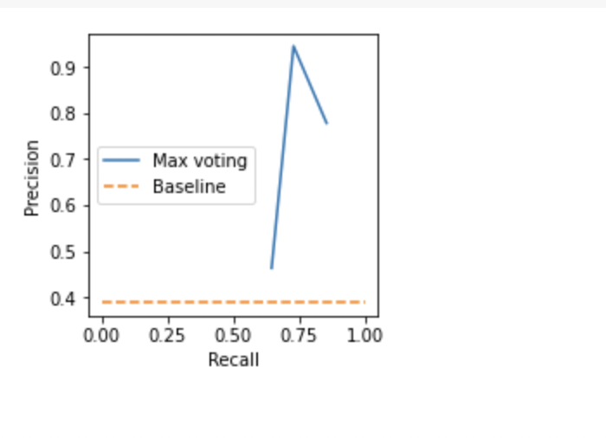
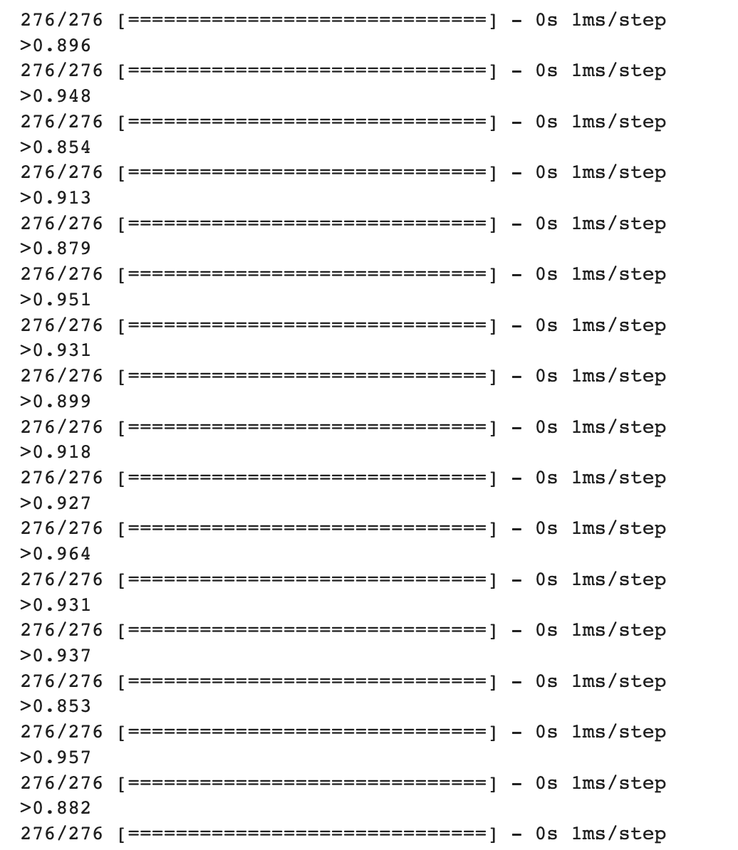
Machine Learning Model Building
Recurrent Neural Network
Precision Recall Curve :
Precision, Recall, Accuracy, F1 score:
Convolutional Neural Network
Evaluation performed and the accuracy got:

Slide 12
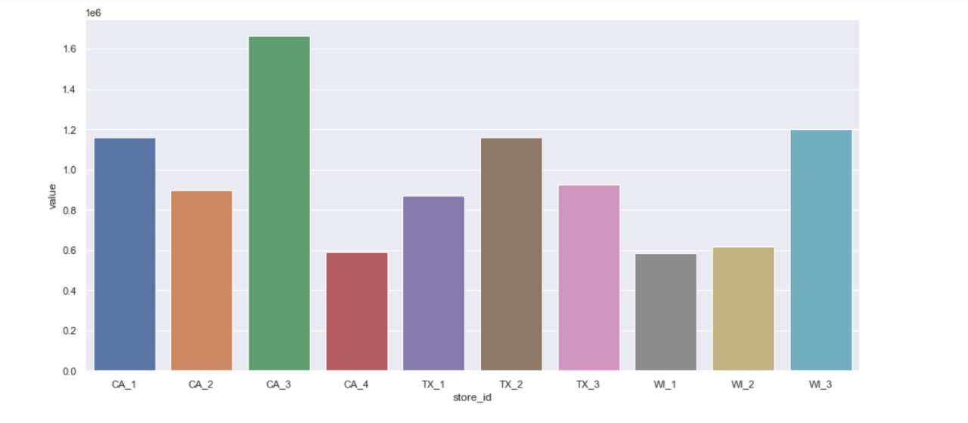
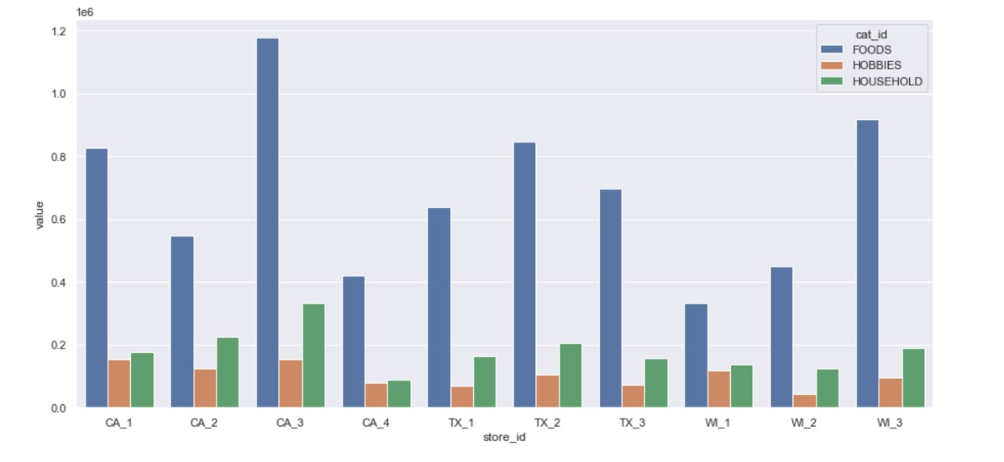
Machine Learning Model Building
Data Preprocessing: data preprocessing can refer to manipulation or dropping of data before it is used in order to ensure or enhance performance.
Exploratory Data analysis: exploratory data analysis is an approach of analyzing data sets to summarize their main characteristics, often using statistical graphics and other data visualization methods
The graph represents the number sales in different stores on three different states. Its plotted in between the value and it’s store id.
The second graph represents the number of sales in different categories like foods, hobbies and household. The bar graph in these categories are plotted on different stores like store id versus their value.

Slide 13
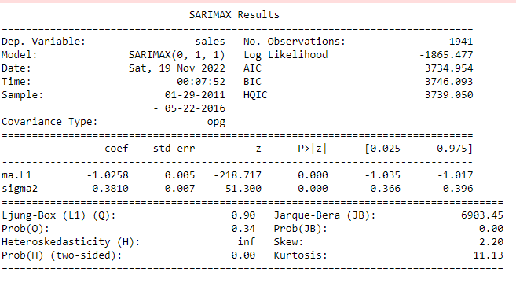
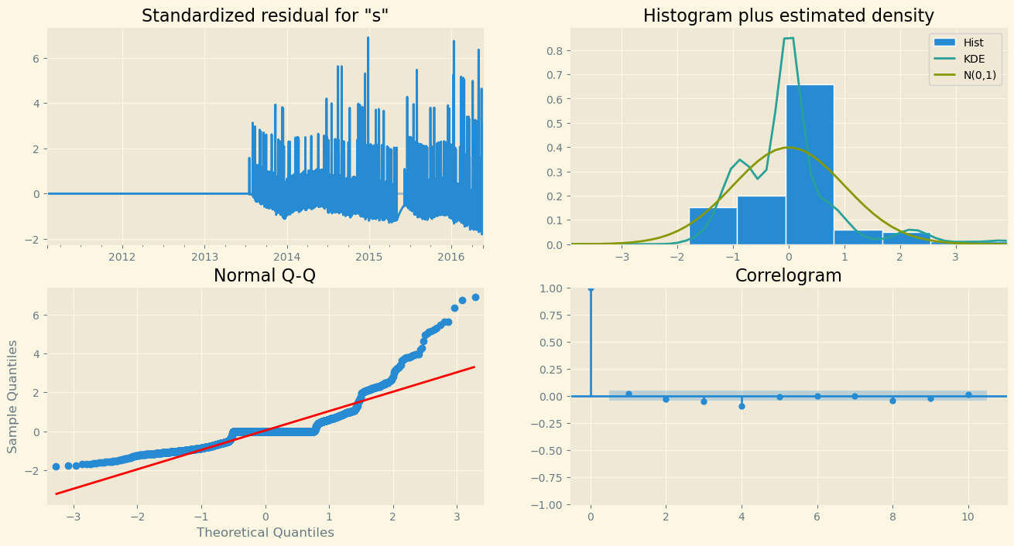
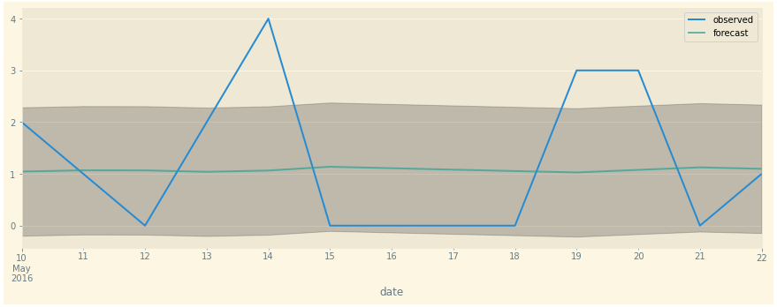
Machine Learning Model Building
ARIMA model Summary
ARIMA model Diagnostics
RMSE VALUE : 1.20
ARIMA model Forecasting

Slide 14
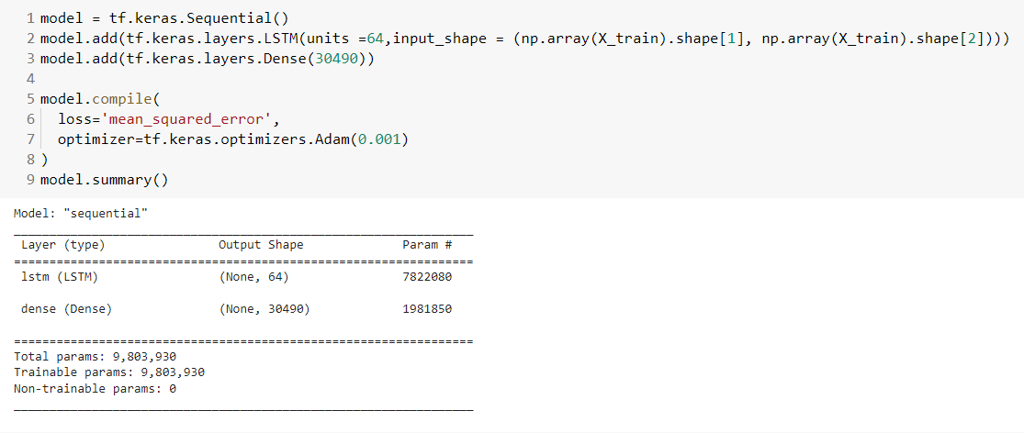

Machine Learning Model Building
LSTM
LSTM Model

Slide 15


Model deployment and business recommendation
Streamlit deployment
ARIMA model deployment using Streamlit
ABC analysis
ABC analysis of household category of 1 year data using sales and selling price has been performed.
We have constructed a table for each item in this household category and calculated its revenue based on the number of sales and it’s selling price per unit.
We have also extracted the run percentage, run cost, and categorized all the items in three classes A, B and C.
The classification is based on sales, total revenue generation.
In which, we have class A with highest revenue generation.

Slide 16








Model deployment and business recommendation
How stable is the customers’ demand?
Few initiatives and recommendations for improving the retail business
Graph analysis in terms of ABC for days which has low sales

Slide 17







Model deployment and business recommendation
Graph analysis in terms of demand variability distribution
Performed analysis to give more sale insights for particular departments.

Slide 18
THANK YOU

